Slide 1
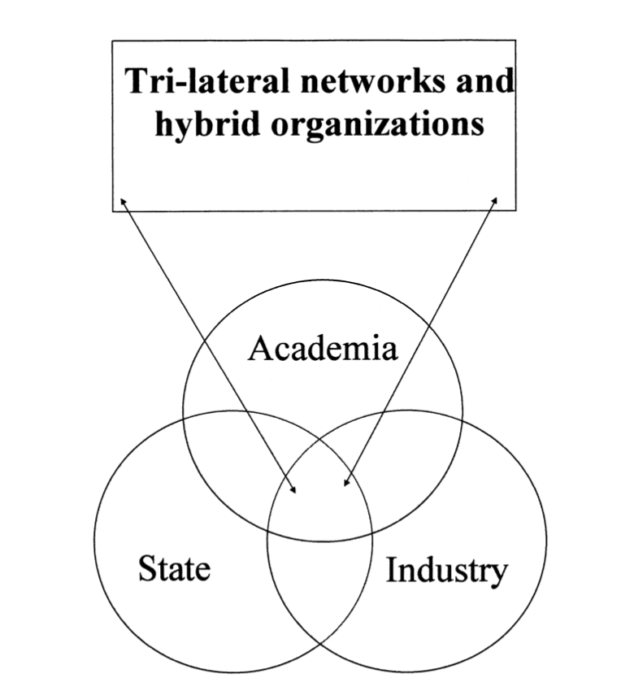
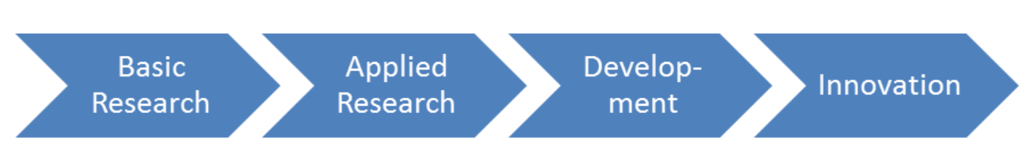
Differences: between the innovation systems approach and the Triple Helix approach
Figure 1: The linear model of innovation system
The difference is in the way the actors in both approaches (private, public and academia sectors) interact and collaborate with each other. The Triple Helix approach is more concentrate on responsible innovation and the agent response directly to the other agent. Given the interactions between the three sectors the innovation process is more complex than the linear model in innovation system approach.
Figure 2:The Triple Helix Model
Werker, C. (2017) & Godin, B. (2006) & H. Etzkowitz, L. Leydesdorffr (2000)

